Slide 1
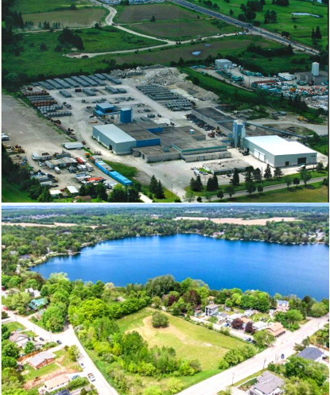
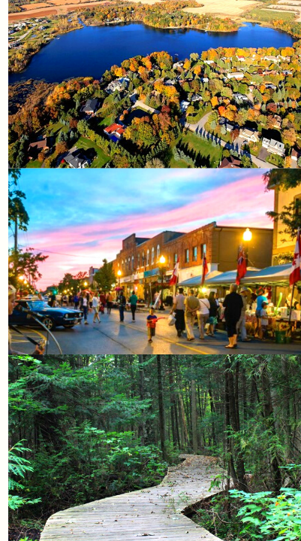


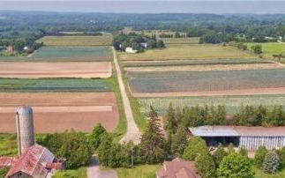

Public Open House
October 7th, 2021

Slide 2

Introductions - The Official Plan Team
      Meaghan Craven, Manager, Planning Policy
      Randall Roth, Senior Policy Planner
      Zahrah Khan, Policy Planner II
      Gregory Bender, Project Manager
      Alejandro Cifuentes, Deputy Project Manager and Policy Lead
      Andria Sallese, Engagement Advisor & Senior Planner
      Nick Trajkovski, Planner
      Natalie Armstrong, Planner & Engagement Support

Slide 3
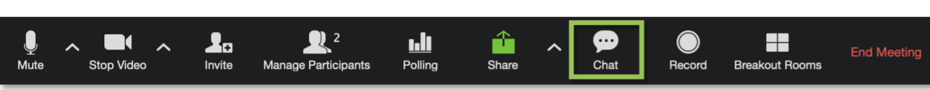
Housekeeping Items
1. Your mic will be automatically muted. You can participate in the meeting by asking a question using the Chat Function.
2. You can also submit your questions or comments to the Town by email: opreview@townofws.ca.
3. This presentation will be recorded.

Slide 4
Agenda Overview
Introductions
Status of Official Plan Review Program
Policy Directions Report and Key Policy Areas
Upcoming Deliverables and Next Steps
Questions & Answers Session
Notes:
Christine

Slide 5
Session Purpose and Objectives
Purpose:
To provide a status update of the Official Plan Review project, an overview of policy directions and key policy areas, engagement events held to date, and provide information on how to further participate in the Official Plan Review process.
Objectives:
To identify opportunities as they relate to growth management and economic development, complete communities, planning for the natural environment and planning administration, implementation and interpretation matters.
To provide an overview of draft Policy Directions Report.
To provide information regarding the approach to developing policy directions and the new Town Official Plan.
Notes:
Christine

Slide 6
Status of Official Plan Review Program
Notes:
Greg

Slide 7




Project Deliverables and Work Program
Phase 1
Phase 2
Phase 3
Phase 4
Visioning and Consultation
Communications Plan
Introductory Project Committee Meetings (TAC/SC/SAC)
Initial Open House
Community Visioning Workshop
Visioning Report
Background Studies and Discussion Papers
Data Collection
Discussion Papers
Feedback from TAC/SC/SAC
Second Public Open House and Council Meeting
Policy Development
Policy Direction Reports
Feedback from TAC/SC/SAC
Third Public Open House and Council presentation
Draft Official Plan
Official Plan Amendment(s)
Final Official Plan
Feedback from TAC/SC/SAC
Final Public Open House and Public Meeting
Council Adoption
Submission to Region
Phase 1
Phase 3
2020
2021
2022
Phase 2
Phase 4
We are Here!
Notes:
MAJOR MILESTONES:
Summer 2020 - Communications and Engagement Strategy
Fall 2020 - Public Open House and Survey #1 Presentation to Council
Winter 2021 - Community Vision Summary Report
Winter 2021 - Preparation of Draft Discussion Papers
Spring 2021 - Public Open House and Survey #2
Summer 2021 -Finalize Discussion Papers and Council Meeting #2
Fall 2021 - Policy Directions Report

Slide 8
Policy Directions Report and Key Policy Areas

Slide 9
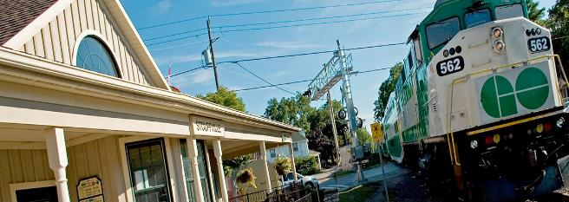
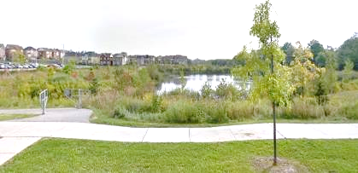
Purpose of Policy Directions Report
To identify preferred policy directions and to address policy conformity gaps that will be the basis for formulating the new Town Official Plan.
Directions put forth in this Report are key to applying and promoting provincial planning interests, regional interests and detailed local planning considerations.
The Report will help formulate a set of policy directions that will serve as the basis of forthcoming detailed policy creation for the development of a new Official Plan.
Notes:
Greg

Slide 10

Policy Directions - Key Policy Areas
Planning for Growth
Planning for the Natural Environment
Planning for Complete Communities
General Technical / Housekeeping Updates
Notes:
Greg

Slide 11
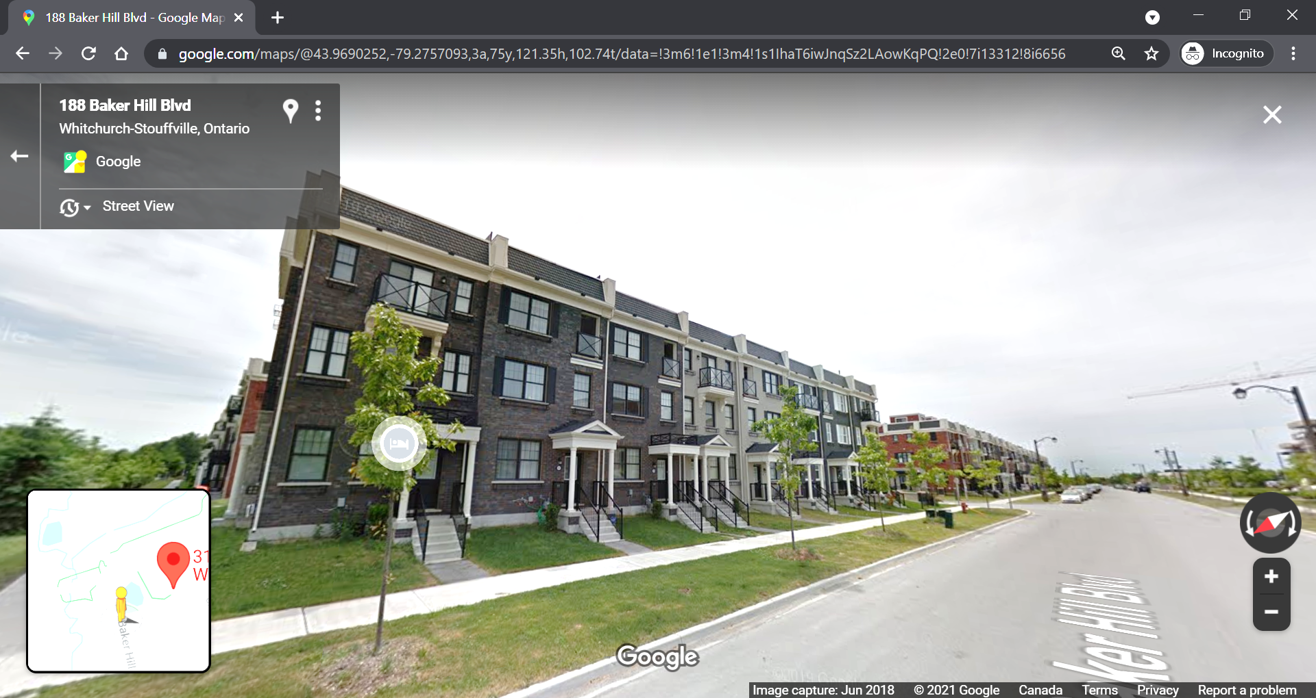
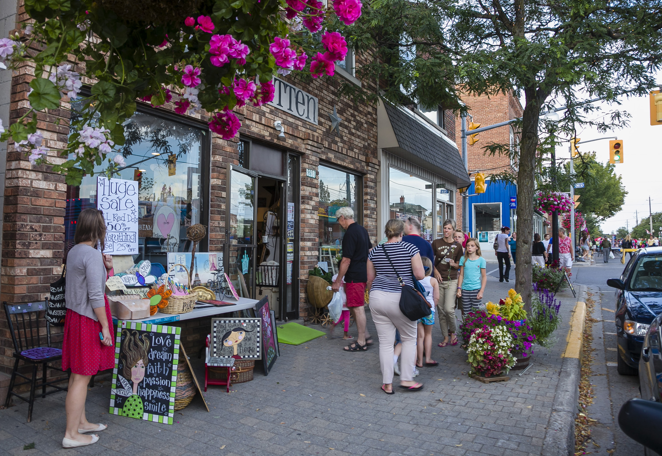
Key Policy Directions: Planning for Growth
Theme Objective:
Ensure smart growth through directing residential and employment growth in the Town’s built-up areas.
Policy Directions:
Establish Town-wide minimum built-up area intensification target of 21% and minimum greenfield density target of 50 residents and jobs per hectare. Note: May be revised through Regional MCR.
Implement phasing policies for intensification areas, and new community areas.
Implement context sensitive development criteria to protect character of existing communities.
Maintain employment areas as large and cohesive areas for industrial, manufacturing, warehousing, etc.
Notes:
Greg

Slide 12
Key Policy Directions: Planning for Growth
Theme Objective:
Ensure smart growth through directing residential and employment growth in the Town’s built-up areas.
Policy Directions:
Ensure a variety of transportation connections to employment/commercial areas within a 15-minute walk or bike ride from residential areas.
Implement policies that support active forms of mobility.
Support the implementation of a “Vision Zero” program focused on reducing traffic-related fatalities and serious injuries.
Notes:
Greg

Slide 13
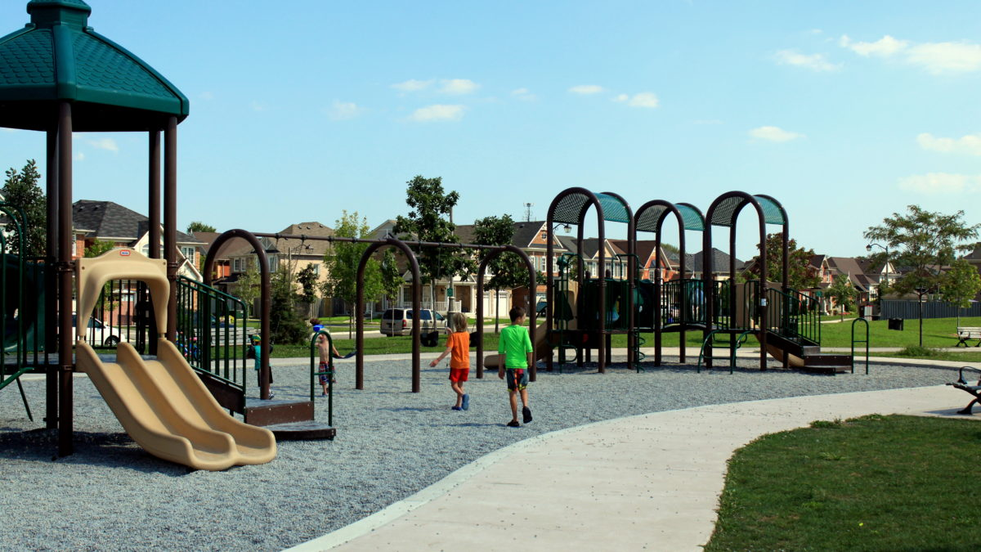
Key Policy Directions: Planning for Complete Communities
Theme Objective:
Promote the Town as a place where homes, jobs, schools, community services, parks and recreational facilities are easily accessible, and support a high quality of life.
Policy Directions:
Encourage the provision of a full range of housing options, including ownership and rental housing, social housing, housing for seniors, and additional residential units.
Promote the development of a comprehensive parks, open space and trails network.
Promote the use of community gardens, local farms market and urban agriculture.
Ensure public realm is designed to provide safe, attractive, interesting and comfortable spaces for pedestrians.
Notes:
Greg

Slide 14
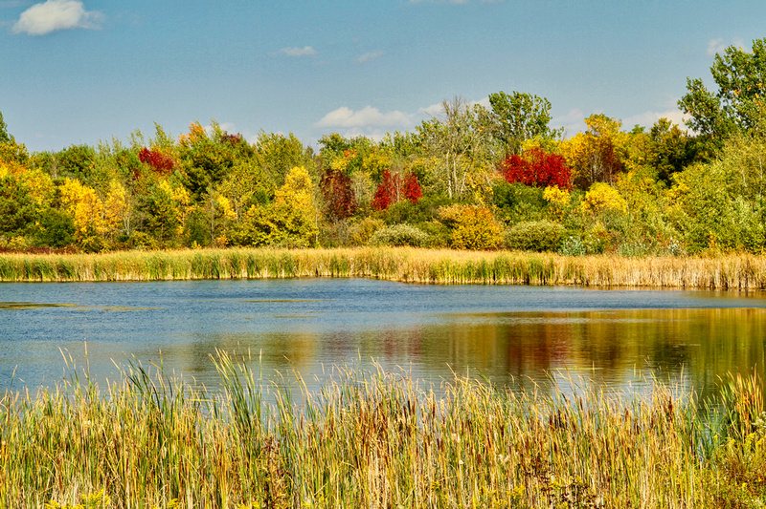
Key Policy Directions: Planning for the Natural Environment
Theme Objective:
Promote the Town’s natural environment through the protection of natural areas and integrating the environment as part of future growth.
Policy Directions:
Update policies related to the protection of prime agricultural lands consistent with provincial policies.
Promote countryside tourism and agri-tourism. This includes agricultural fairs, farmers markets and events.
Allow secondary dwellings for the purposes of farming help within existing buildings, when possible.
Notes:
Greg

Slide 15
Key Policy Directions: Planning for the Natural Environment
Theme Objective:
Promote the Town’s natural environment through the protection of natural areas and integrating the environment as part of future growth.
Policy Directions:
Require new development and redevelopment to incorporate native and drought tolerant vegetation.
Implement policies that address the impacts of climate change on the natural environment.
Implement innovative solutions to ensure open space linkages to serve as recreational and wildlife linkages.
Promote the management of invasive species.
Notes:
Greg

Slide 16





Key Policy Directions: General Technical & Housekeeping Updates
Theme Objective:
Ensure that the new Town Official Plan is accessible and understandable to all, and conforms to updated provincial requirements.
Policy Directions:
Develop legible and easy-to-understand Schedules and Figures that will assist the readers in understanding the Official Plan.
Ensure the new Official Plan meets and considers Accessibility for Ontarians with Disabilities Act (AODA) standards.
Develop a new set of comprehensive definitions to ensure that they are clear, contemporary and are in conformity with Provincial legislation and the Regional Official Plan.
Notes:
Greg

Slide 17
Key Policy Directions: General Technical & Housekeeping Updates
Theme Objective:
Ensure that the new Town Official Plan is accessible and understandable to all, and conforms to updated provincial requirements.
Policy Directions:
Review public notification and consultation policies to drive more meaningful, effective and inclusive public involvement in planning decisions.
Include an Indigenous Land Acknowledgment in the new Town Official Plan.
Develop policies that are performance or results-based.
Notes:
Greg

Slide 18

NEXT STEPS

Slide 19
Upcoming Deliverables & Next Steps
OCT. 7, 2021
NOV. 16, 2021
WINTER 2021 / 2022
WINTER 2021 / 2022
SUMMER2022
Public Open Houses
Present Policy Directions Report to Council
Develop Draft Official Plan
Ongoing Consultation with Project Committees
Adoption of New Official Plan

Slide 20
Questions & Answers

Slide 21
How to Participate?
Your mic will be automatically muted. You can participate in the meeting by asking a question using the Chat Function.
Notes:
Christine

Slide 22
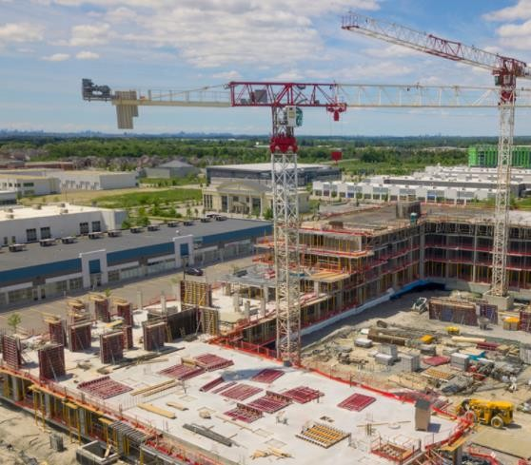
Planning for Growth
How would you make sure that growth occurs in a way that is compatible with existing communities?

Slide 23
Planning for Complete Communities
Housing affordability is an important topic the Town has chosen to focus on. What tools should the Town consider to support affordable housing?

Slide 24
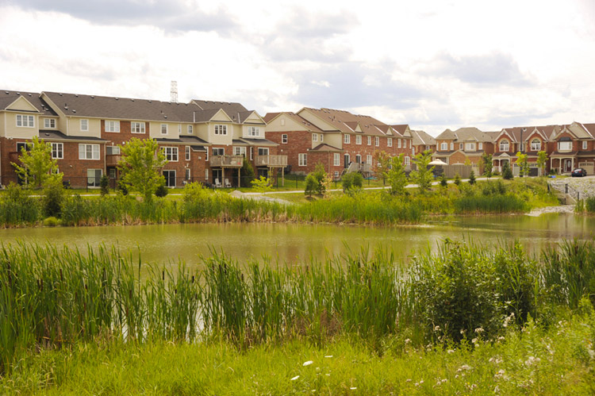
Planning for the Natural Environment
Developing sustainable communities is an important objective to the Town. What does “sustainability” mean to you?

Slide 25


Contact us!
Meaghan Craven. Manager, Planning Policy
(905) 640-1910 ext. 2359
Randall Roth, Senior Policy Planner
(905) 640-1910 ext. 2260
Zahrah Khan, Policy Planner II
(905) 640-1910 ext. 2329
Email us!
opreview@townofws.ca
Visit the Project Webpage to Sign
Up for the Interested Parties List
www.cometogetherws.ca/opr
Contact the Town Directly with Questions or to Provide Comments
Notes:
Christine

Slide 26
THANK
YOU!

